Slide 1

Data Structures and Algorithms Ch4: graphs 74
University of Montevallo
Spring 2021

Slide 2
Section 4.1 Undirected Graphs

Slide 3
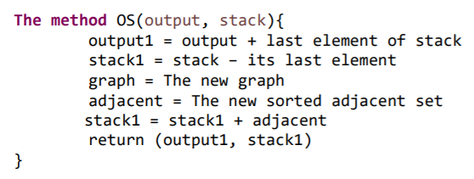
A quick review on the 5 last sessions

Slide 4
What are we about to today?
Run the OS method of the class Graph you made last session to make sure it works well.

Slide 5
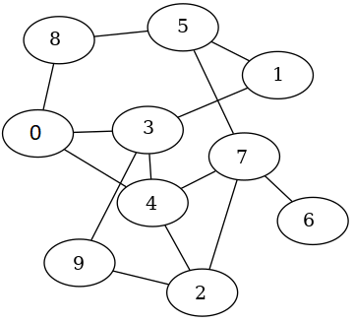
Activity 1
Note: The next slide is the answer to this activity so do not proceed until you are done with the activity.
Create the graph above with Java.

Slide 6
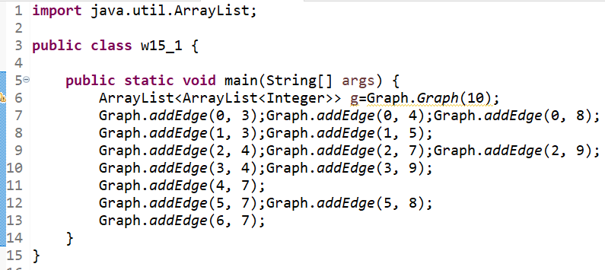

Slide 7
Activity 2
Note: The next slide is the answer to this activity so do not proceed until you are done with the activity.
Continue activity 1 by running OS with current output={4} and current stack={7, 3, 2, 0}. The output must be new output={4, 0} and new stack={7, 2, 8, 3}.

Slide 8
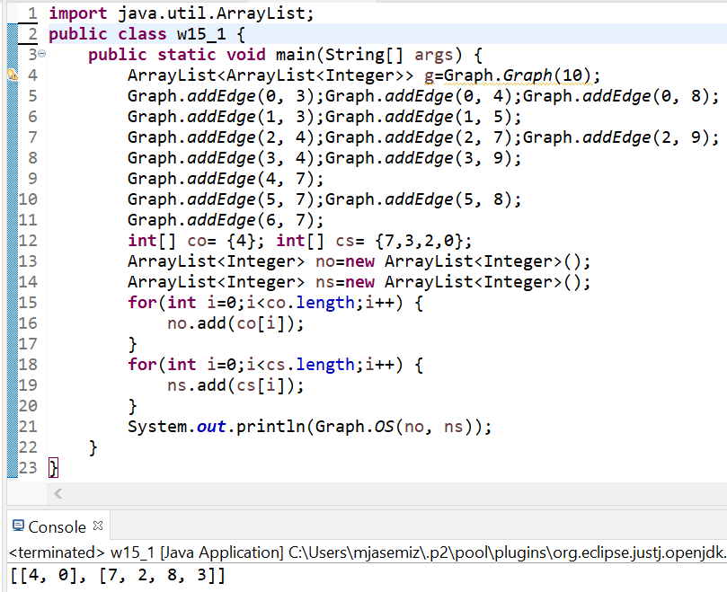

Slide 9
Activity 3
Note: The next slide is the answer to this activity so do not proceed until you are done with the activity.
Continue activity 2 by getting what it returns as current output and stack to get the new output and stack. The output must be new output={4, 0, 3} and new stack={7, 2, 8, 9, 1}.

Slide 10
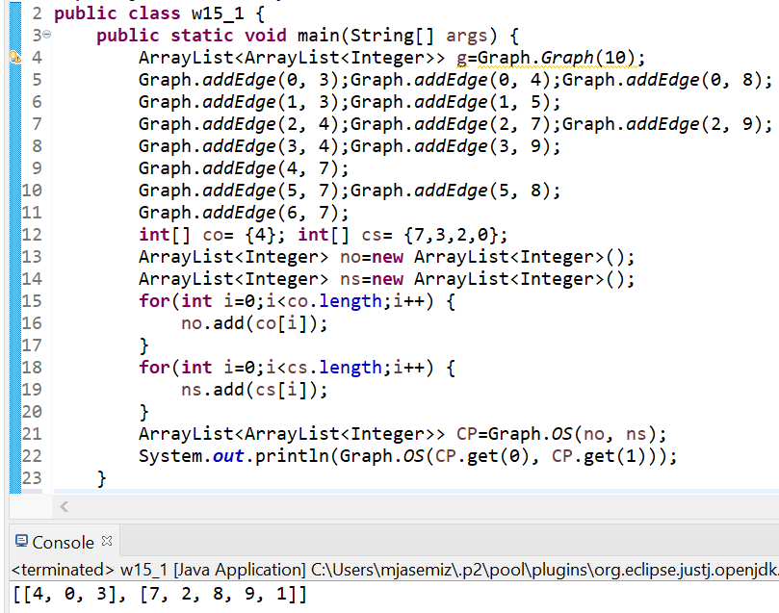

Slide 11
Stay Safe & Happy

